Slide 1
Evaluation of your data collection & information retrieval system- Homework 1
Dilara Alkanalka 50251145

Slide 2
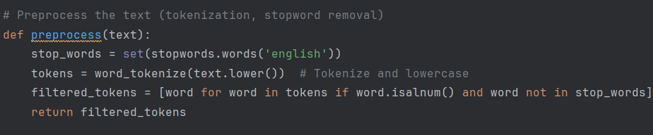
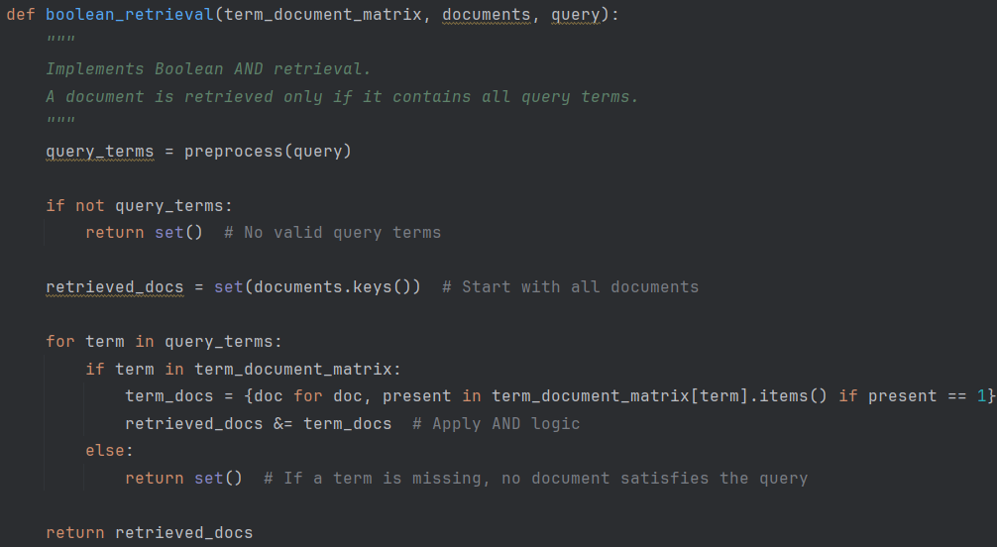
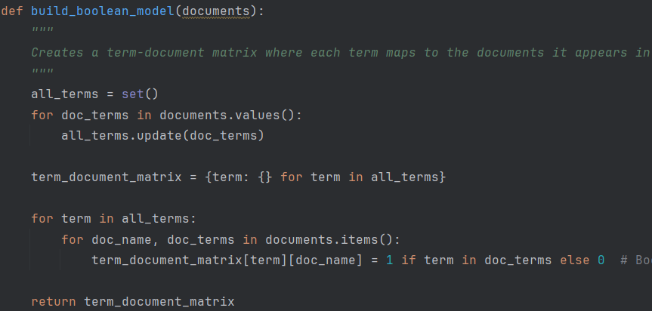
First steps (my data collection was about news articles):
1-Some Basic Preprocessing
2-Boolean Model Construction
3-Boolean Retrieval with AND logic

Slide 3
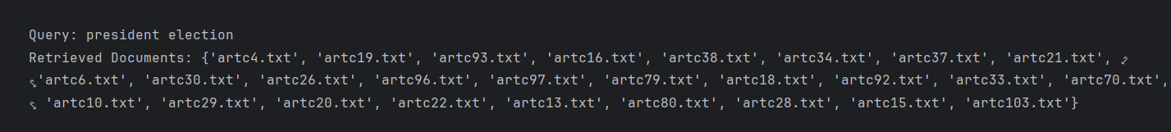
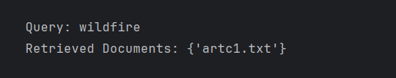
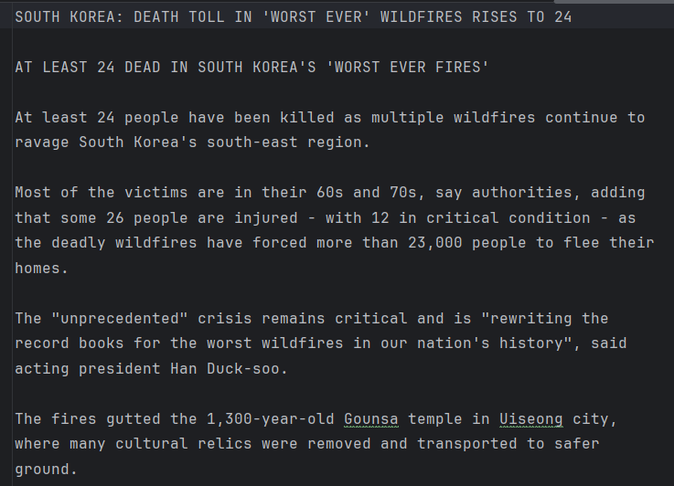
As an example, if we enter ‘president election’ as a query the output looks like this:
If we enter ‘ wildfire’ as the query output looks like this:
The artc1.txt is indeed about the news of wildfires, →
I will show more details about relevance in later slides
artc1.txt

Slide 4
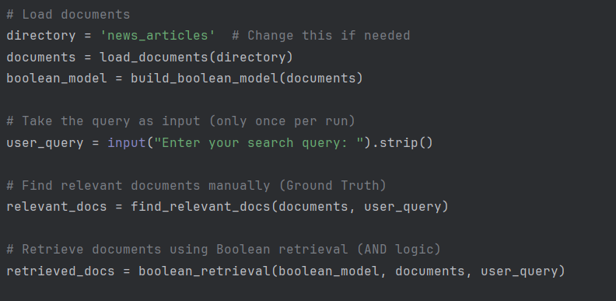
Then I adjusted the code to take the query as a user input for dynamical query search.
This code also calculates the precision and recall but it assumes all the texts that have the query are relevant which is not always the case.

Slide 5
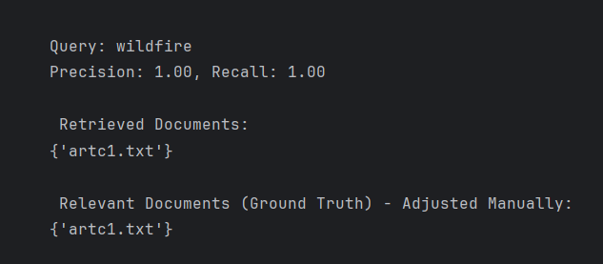
To determine precision and relevance rate better, I tried some test case queries and chacked whether those retrieved texts are actually ‘relevant’ by deciding on a relevant data set manually.
In this case since there is only one article about the wildfires and as I showed it is relevant so the Precission is 1.00

Slide 6
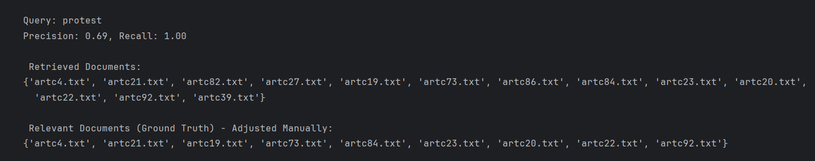
Next I choose ‘protest’ as a query
Based on the relevance set I decided on, the Precision is calculated as 0.69
The titles of articles that I found relevant:
Thousands turn out in Turkey for protests after more than 1,400 arrests
Turkey protests are about far more than fate of Istanbul's mayor
Turkey protests: sixth night of demonstrations as Erdogan hits out at unrest
Serbia: government denies using 'sonic cannon' at protests
Second night of protest breaks out in Istanbul despite ban
Columbia student protester sues Trump administration to stop deportation
Turkey protests: why thousands are protesting Imamoglu's arrest
Political free fall: Turkey faces protests, investor flight after opposition leader's arrest
The titles of articles that I did not found relevant:
Final push for votes as German frontrunner vows to lead in Europe
Judge argues US treated Nazis better than Venezuelan migrants who were deported
Fbi launches Tesla threats task force: 'this is domestic terrorism'
Columbia University agrees to several Trump demands

Slide 7
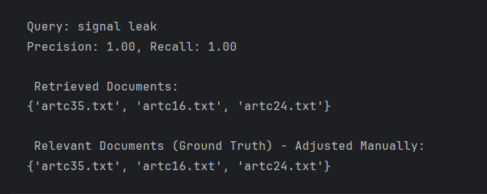
Next I choose ‘signal leak’ as a query
Based on the relevance set I decided on, the Precision is calculated as 1.00
The titles of articles that I found relevant:
Trump and intelligence chiefs play down Signal group chat leak
Why is it a problem if Yemen strike plans shared on Signal?
Mike waltz takes 'full responsibility' for Signal group chat leak

Slide 8
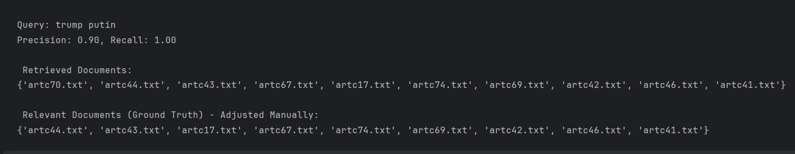
Next I choose ‘trump putin’ as a query
Based on the relevance set I decided on, the Precision is calculated as 0.90
The titles of articles that I found relevant:
How Trump blew up the world order - and left Europe scrabbling
Trump suggests US control of Ukraine’s power plants in Zelensky call
Why Trump is struggling to secure fast ceasefire in Ukraine
Ukraine's 'chaotic' withdrawal from Russia, in its soldiers' words
Russia and Ukraine agree naval ceasefire in Black Sea
Putin gives trump bare minimum on Ukraine but the war goes on
Trump envoy dismisses starmer plan for Ukraine
Rosenberg: Trump-Putin call seen as victory in Russia
The titles of articles that I did not found relevant:
Germany set to vote on historic increase in defence spending
Germany votes for historic boost to defence and infrastructure spending

Slide 9
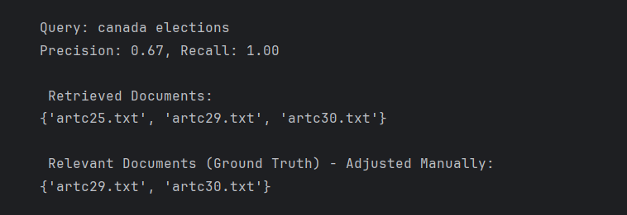
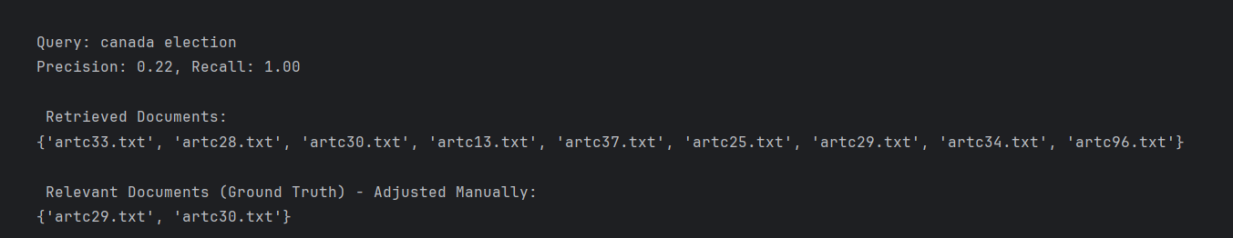
Next I choose ‘canada elections’ as a query
The titles of articles that I found relevant:
HOW DOES CANADA'S GENERAL ELECTION WORK? A SIMPLE GUIDE
WHO'S WHO IN CANADA'S FEDERAL ELECTION
The titles of articles that I did not found relevant:
INDIA ACCUSED OF MEDDLING IN CANADA'S CONSERVATIVE PARTY LEADERSHIP RACE
Based on the relevance set I decided on, the Precision is calculated as 0.67
But I tried searching for ‘canada election’ and there were more retrieved documents, and they were indeed was relevant with the elections in Canada. So we can say that there were ‘ false negatives’ -documents that were relevant but not retrieved. As a result, the precision for the earlier query was actually higher, but it does not mean the search was more effective.

Slide 10
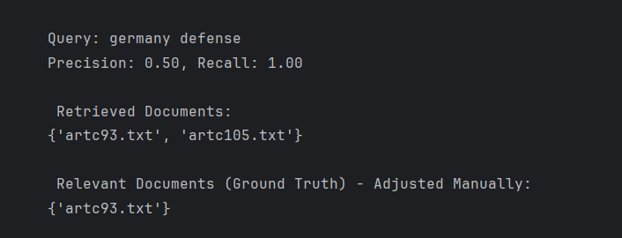
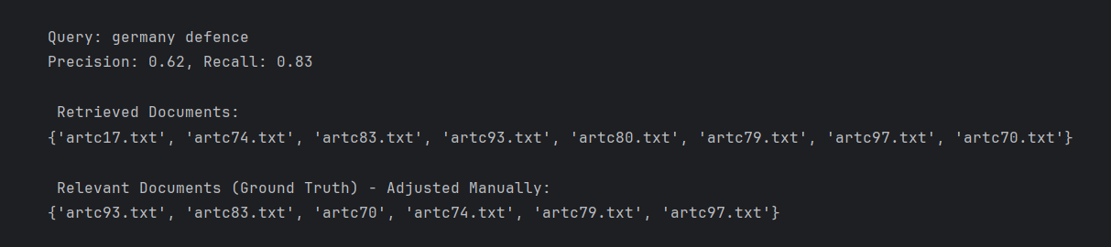
Next I choose ‘germany defense’ as a query
The titles of articles that I found relevant:
GERMAN PARLIAMENT PASSES HISTORIC DEBT REFORM, PAVING THE WAY FOR
HIGHER DEFENSE SPEND
Based on the relevance set I decided on, the Precision is calculated as 0.50
However again, it seemed like not all the relevant documents were retrieved causing ‘false negatives’ so I checked some articles manually; and found out in some articles it is written as ‘defence’ instead of ‘defense’:
The retrieved documents were indeed relevant with article titles like:
GERMANY SET TO VOTE ON HISTORIC INCREASE IN DEFENCE SPENDING
The second query results make more sense but the user may search with both ‘defence’ or ‘defense’, so there is room for improvement for cases like this.

Slide 11
Results and Discussions
During the testing, various queries have been searched with a Boolean Retrieval Model , and here are some key aspects that can be derived from these tests:
Impact of Query Wording: Searches for "Canada election" vs. "Canada elections" resulted in different sets of retrieved documents. This shows how singular vs. plural forms affect retrieval, as the Boolean model strictly matches words without considering linguistic variations.
Similarly, "Germany defence" vs. "Germany defense" retrieved different documents due to spelling differences between British and American English. This demonstrates a limitation of exact word matching in Boolean retrieval.
False Negatives and Missed Documents: In some cases, relevant documents were missing from the retrieved set (false negatives). This happened when the search terms did not exactly match words in the documents, reducing recall.
Manual Identification of Relevant Documents: The Boolean model does not automatically determine which documents are truly relevant to the user’s intent. Instead, after retrieving results, relevant documents had to be manually checked to compare them against the retrieved set.
Possible Improvements for Better Testing:
First, expanding the dataset by including more diverse and larger collections of documents would provide a better understanding of how the model performs across different topics and writing styles. Additionally, incorporating a predefined relevance judgment set—such as having multiple users independently assess which documents are truly relevant—would make precision and recall measurements more objective, reducing the bias of manual selection. Another improvement could be allowing phrase searches or synonym expansion, which would help mitigate issues where small variations in query wording lead to different results.

